Slide 1
My Perimeter, Area and Volume Interactive Notebook
Name
Class
Term 3 Semester 2

Slide 2
Contents
Formula Page
Page
Date
Description
2
3

Slide 3
Tasks
24
7
30
Essential Question
Questions
Notes
Summary
10
11

Slide 4
24
7
30
Date
Units for Area
EQ – How do I convert between units of area.
Area – Is a measure of surface
11

Slide 5
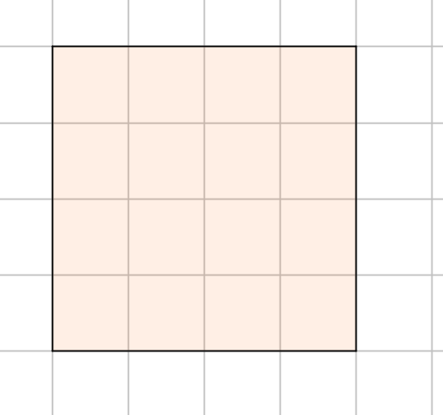


24
7
30
Date
Units for Area
EQ – How do I convert between units of area.
Area – Is a measure of surface
$$l$$
$$l$$
11

Slide 6

24
7
30
Date
Units for Area
EQ – How do I convert between units of area.
Area – Is a measure of surface
How many square centimetres make up the surface of the square?
$$l$$
$$16{cm}^{2}$$
$$l$$
11

Slide 7


24
7
30
Date
Units for Area
EQ – How do I convert between units of area.
Area – Is a measure of surface
How many square centimetres make up the surface of the square?
$$l$$
$$16{cm}^{2}$$
Same as $l×l$
$$l$$
11

Slide 8
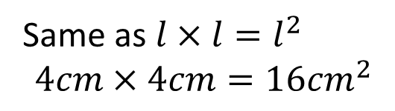

24
7
30
Date
Units for Area
EQ – How do I convert between units of area.
Area – Is a measure of surface
How many square centimetres make up the surface of the square?
$$l$$
$$16{cm}^{2}$$
Same as $l×l=l^{2}$
$$4cm×4cm=16{cm}^{2}$$
$$l$$
11

Slide 9
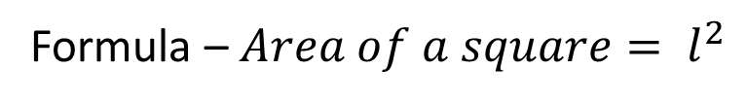
24
7
30
Date
Units for Area
EQ – How do I convert between units of area.
Area – Is a measure of surface
How many square centimetres make up the surface of the square?
$$l$$
$$16{cm}^{2}$$
Same as $l×l=l^{2}$
$$4cm×4cm=16{cm}^{2}$$
$$l$$
Formula – $Area of a square= l^{2}$
11

Slide 10
Task-Find the area of the squares
10mm
1cm
100cm
1m
1000m
1km

Slide 11
24
7
30
Date
Units for Area
EQ – How do I convert between units of area.
Converting Units
km ² m ² cm ² mm ²
11

Slide 12
24
7
30
Date
Units for Area
EQ – How do I convert between units of area.
Converting Units
x1000 ² x 100 ² x10 ²
km ² m ² cm ² mm ²
11

Slide 13
24
7
30
Date
Units for Area
EQ – How do I convert between units of area.
Converting Units
x1000 ² x 100 ² x10 ²
km ² m ² cm ² mm ²
11

Slide 14

24
7
30
Date
Units for Area
EQ – How do I convert between units of area.
Converting Units
x1000 ² x 100 ² x10 ²
km ² m ² cm ² mm ²
$÷$1000 ² $÷$100 ² $÷$10 ²
11

Slide 15
24
7
30
Date
Units for Area
EQ – How do I convert between units of area.
Converting Units
x1000 ² x 100 ² x10 ²
km ² m ² cm ² mm ²
$÷$1000 ² $÷$100 ² $÷$10 ²
Examples
Change 5cm² to mm²
2. Change 8 000 00 m² to cm²
11

Slide 16
Task
Write in the questions for the notes taken in todays lesson

Slide 17
Notes Review
24, 7 ,30
Date
Title
Essential question
Notes complete
Notes complete with colour and diagrams
Questions completed
Contents page filed in
Formula page filled in

Slide 18
Homework
Review your notes and write a summary answering the essential question.

Slide 19
Plenary
Draw three shapes with a perimeter of 36cm.

